Slide 1
Lecture 35 Thyristor Characteristics

Slide 2
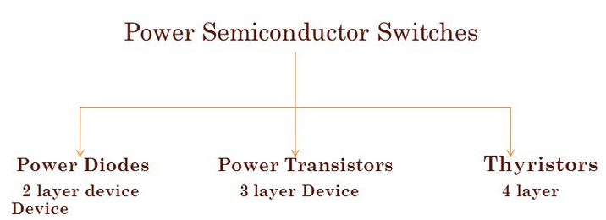
Introduction
The name Thyristor comes from two similar device names ‘Thyratron’ and ‘Transistor’
A thyratron is a type of gas-filled tube used as a high-power electrical switch and controlled rectifier
Thyristors can handle high voltage/current in power applications and fast switching
The most common thyristor is the SCR which stands for “Silicon Controlled Rectifier”

Slide 3
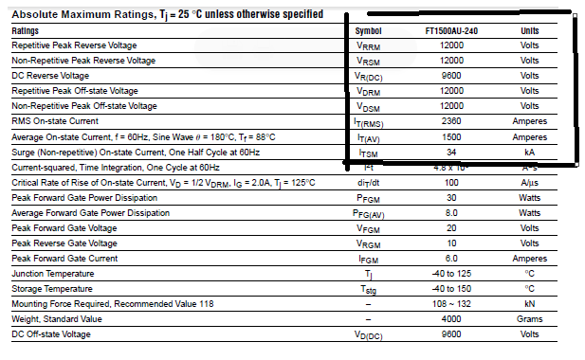
Datasheet Specification of a typical Thyristor

Slide 4
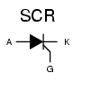
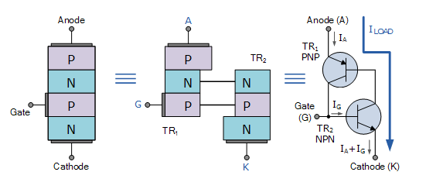
Symbol and Equivalent Circuit
SCR has 3 terminals
(gate provides control)
SCR is turned on by applying +ve gate signal when anode is +ve with respect to cathode.
SCR is turned off by interrupting anode current.

Slide 5
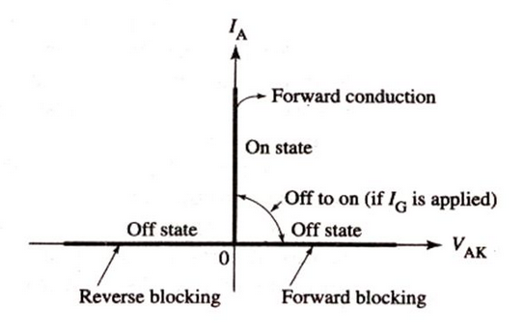
Ideal Characteristics of SCR

Slide 6
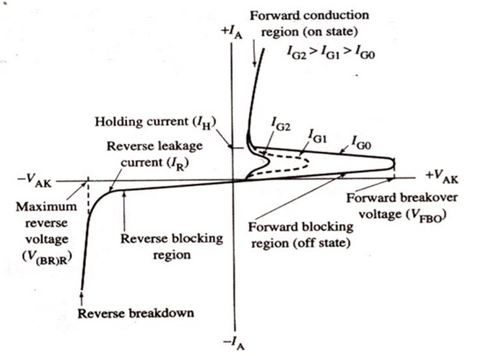
SCR Characteristic Curve
Three modes of operation:
Reverse Blocking mode
Forward Blocking mode
Forward Active conducting mode

Slide 7
Important Parameters and their Definitions
1. Latching current: Minimum anode current that must flow through the SCR in order to stay ON, after the gate signal is removed.
2. Holding Current: Minimum value of anode current, required to maintain SCR in conducting state.
Obviously then for a thyristor to conduct in the first place, its Anode current, which is also its load current, I_{L} must be greater than its holding current value.
That is I_{L} > I_{H}.

Slide 8
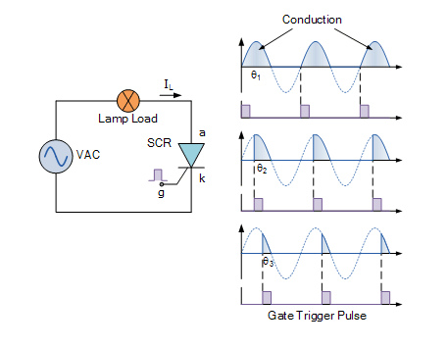
Phase Control using SCR

Slide 9
Summary
Thyristors are semiconductor devices that can operate only in the switching mode.
Thyristor are current operated devices, a small Gate current controls a larger Anode current.
Conducts current only when forward biased and triggering current applied to the Gate.
The thyristor acts like a rectifying diode once it is triggered “ON”.
Anode current must be greater than holding current to maintain conduction.
Blocks current flow when reverse biased, no matter if Gate current is applied.
Once triggered, it will be latched (“ON” – conducting) even when a gate current is no longer applied , providing Anode current is above latching current.

Slide 10
Applications of Thyristors
Rectifiers
Phase Fired Controllers
Light Dimmers
Motor Drive Speed Controllers

Slide 11

Thank You

